Slide 1
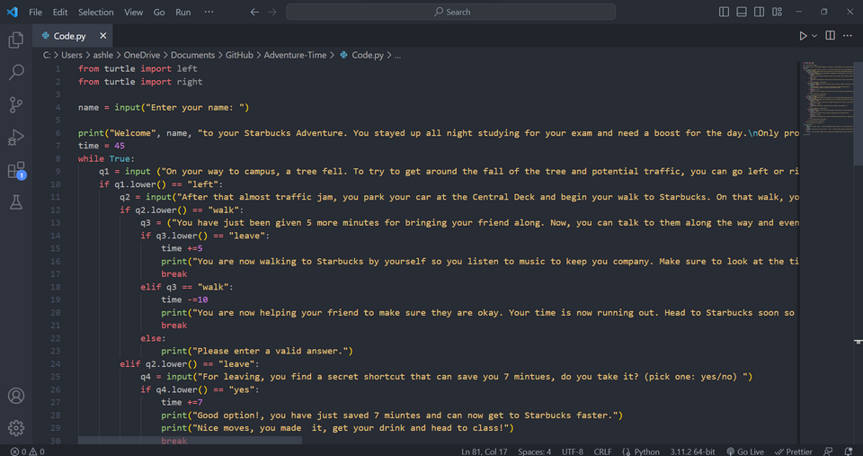
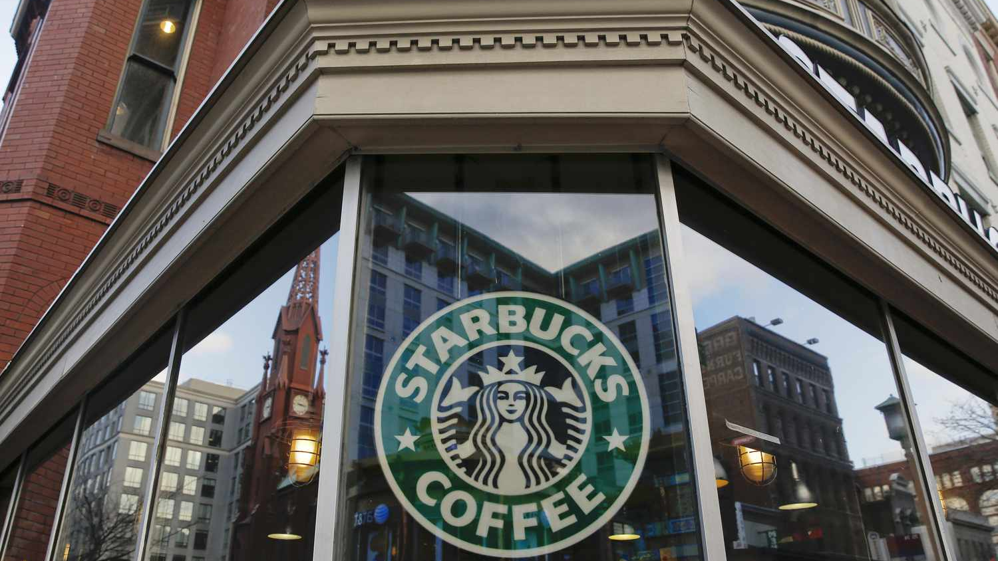
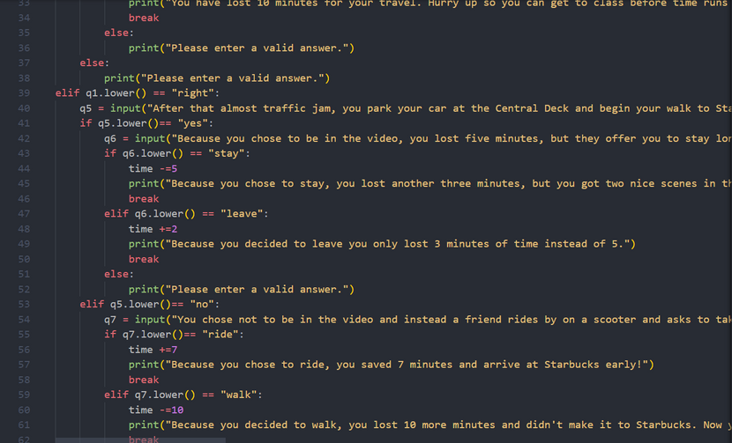

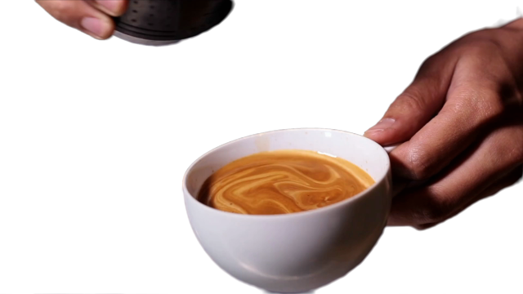
This is a game that allows the user to go through different activities to choose their path to Starbucks.
Alsaline Nim-Dixon & Shinya Ross
Starbucks Adventure

